Slide 1

Sentiment Analysis
Presented By- Lili Mirba

Slide 2

Overview:
Abstract
What is Sentiment Analysis ?
Applications & uses
Advantages
Step by Step process of SA

Slide 3
Abstract
● Now a day, the huge amount of data is posted on daily basis on the social media platform. Twitter also Text messages applications is a well known social networking platform where the user can post their views, opinions, and thoughts freely as a sample. The sentimental analysis is a process of understanding opinions, thoughts and feelings of people about a given subject.
● We have customized & transformed unstructured data into well-informed data for getting the insights of people based on Kids first Client behavior.
● The main focus of the work is to analyze the feelings of people using two well-known API like TextBlob, NLTK.
● This project predicts sentiment into three classes positive Text message , negative(Aggressive Text message) and neutral ( NeturalText message)

Slide 4
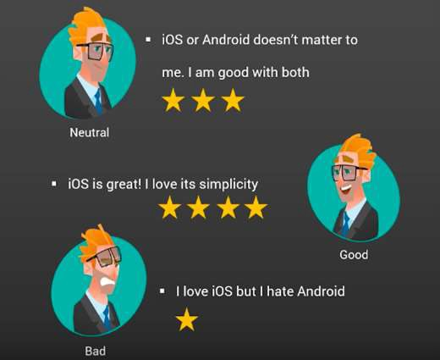
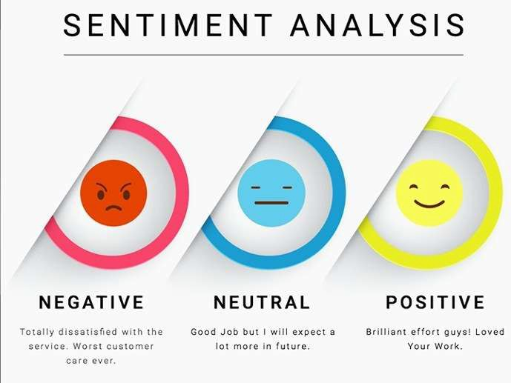

Slide 5

What does Sentiment Analysis mean?
The process of computationally identifying and categorizing opinions expressed in a piece of text, especially in order to determine whether the writer's attitude towards a particular topic, product, etc. is positive, negative, or neutral.

Slide 6

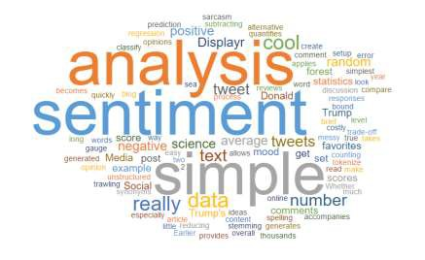
Why Sentiment Analysis?

Slide 7

Sentimental Analysis can used as follows:
Social media monitoring
Brand monitoring
Voice of customer (VoC)
Customer service
Workforce analytics and voice of employee
Product analytics
Market research and analysis

Slide 8

Advantages
Scalability:
Sentiment analysis allows to process data at scale in a efficient and cost-effective way.
Real-time analysis:
A sentiment analysis system can help you immediately identify these kinds of situations and take action.
Consistent criteria:
By using a centralized sentiment analysis system, companies can apply the same criteria to all of their data. This helps to reduce errors and improve data consistency.

Slide 9
What is the use of NLP in Sentiment analysis?
Sentiment Analysis also known as Opinion Mining is a field within Natural Language Processing (NLP) that builds systems that try to identify and extract opinions within text.
A sentiment analysis system for text analysis combines natural language processing (NLP) and machine learning techniques to assign weighted sentiment scores to the entities,
topics, themes and categories within a sentence or phrase.
Natural Language Processing (NLP) is a branch of AI that helps computers to understand, interpret and manipulate human language.

Slide 10

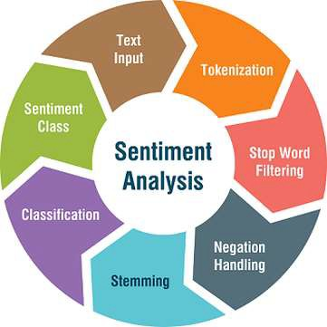
Sentimental Analysis : Step by Step Process

Slide 11
Step 1: Exploratory data analysis (EDA)
Exploratory data analysis (EDA) is used by data scientists to analyze and investigate data sets and summarize their main characteristics, often employing data visualization methods.
In this project:, below sub-steps use to extract , exploratory and cleaning data:
Import Python 'libraries required
Extract data
Descriptive analysis( info, describe, head)
Drop duplications, , drop columns we don’t need
Fill the missing values with unknown tag

Slide 12
Step 2: NLTK (Natural Language Toolkit)
NLTK (Natural Language Toolkit) is the go-to API for NLP (Natural Language Processing) with Python. It is a powerful tool to preprocess text data for further analysis like with ML models for instance. It helps convert text into numbers, which the model can then easily work with.
NLTK is a toolkit build for working with NLP in Python. It provides us various text processing libraries with a lot of test datasets. A variety of tasks can be performed using NLTK such as tokenizing, parse tree visualization, etc
In this project are using a corpus-based approach from NLTK. Corpus is a large body of words or text which formulate a set of conceptual rules that govern a natural language from texts in that language and examine how that language relates to other languages.

Slide 13
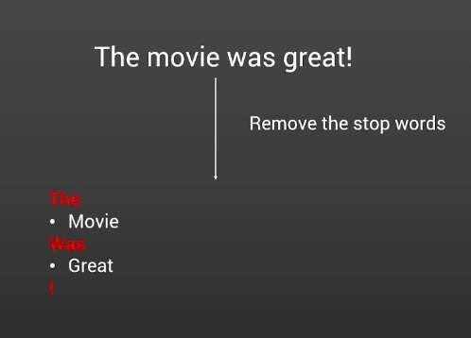
Step 3 : Removing the stop words
One of the major forms of pre- processing is to filter out useless data. In natural language processing, useless words (data), are referred to as stop words.
By importing NLTK packages , we have access to stop words and removing easily.
Note:Stop words are words that are so common they are basically ignored by typical tokenizers. By default, NLTK (Natural Language Toolkit) includes a list of 40 stop words, including: “a”, “an”, “the”, “of”, “in”, etc. The stopwords in nltk are the most common words in data.

Slide 14
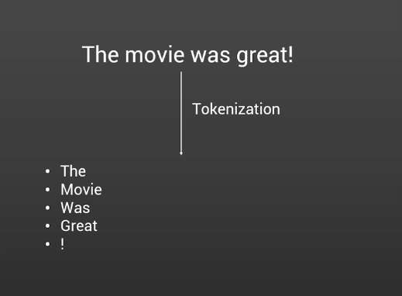
Step 4: Tokenization
Tokenization is the process by which big quantity of text is divided into smaller parts called tokens.
NLTK contains a module called tokenize() which further classifies into two sub-categories: Word tokenize: We use the word_tokenize() method to split a sentence into tokens or words. Sentence tokenize: We use the sent_tokenize() method to split a document or paragraph into sentences and sentences to the words.

Slide 15
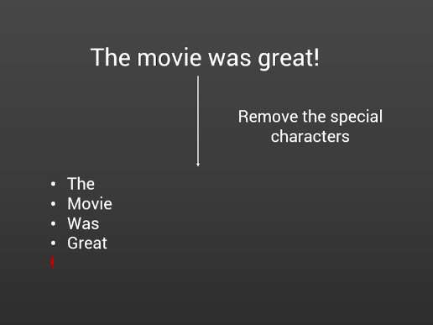
Step 5: Cleaning the data and Lemmatization
Remove numbers
Stemming/lemmatization :Lemmatization in NLTK is the algorithmic process of finding the lemma of a word depending on its meaning and context. Lemmatization usually refers to the morphological analysis of words, which aims to remove inflectional endings. It helps in returning the base or dictionary form of a word known as the lemma.
Part of speech tagging
Remove punctuation
Lowercase

Slide 16
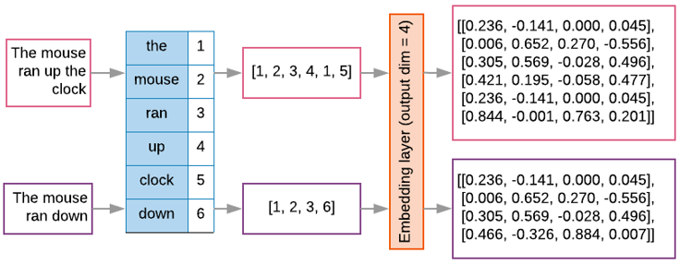
Step 6: Vectorization
Vectorization: The idea is to get some distinct features out of the text for the model to train on, by converting text to numerical vectors
The TfidfVectorizer converts a collection of raw documents into a matrix of TF-IDF features
With Tfidfvectorizer you compute the word counts, idf and tf-idf values all at once.

Slide 17
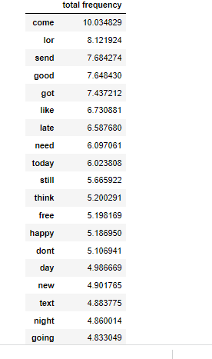
Step 7: word frequency Wordcloud is basically a visualization technique to represent the frequency of words in a text where the size of the word represents its frequency

Slide 18
Step 8:Sentiment Analysis Sentiment analysis is the practice of using algorithms to classify various samples of related text into overall positive and negative categories. With NLTK, you can employ these algorithms through powerful built-in machine learning operations to obtain insights from linguistic data. After assigning individual scores to all the words, final sentiment is calculated by some pooling operation like taking an average of all the sentiments. TextBlob libraries returns polarity and subjectivity of a sentence. Polarity lies between [-1,1], -1 defines a negative sentiment and 1 defines a positive sentiment.

Slide 19
What is Textblob ? TextBlob is a Python (library for processing textual data. It provides a simple API for diving into common natural language processing (NLP) tasks such as part-of-speech tagging, noun phrase extraction, sentiment analysis, classification, translation, and more. We use Textblob for sentiment analysis for this project as per below steps: Import the TextBlob # Add polarities and subjectivities into the DataFrame(API) by using TextBlob # Display the Polarity and Subjectivity columns # Define a function to classify polarities # Display the Polarity and Subjectivity Analysis

Slide 20
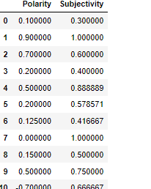
# Visualize the Label counts
# Visualize the Polarity scores
# Display the positive message
# Display the negative message

Slide 21
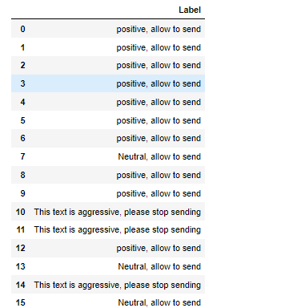
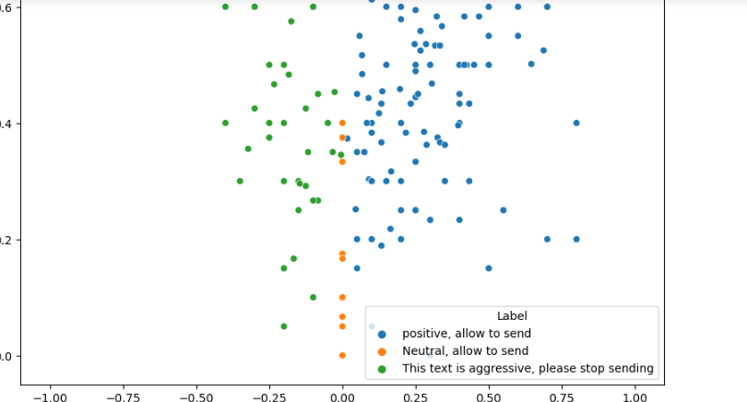

Slide 22

How to classify Sentiment?

Slide 23
Algorithms used :
There are three machine learning classification algorithms that are predominantly used for sentiment analysis:
Support Vector Machines (SVMs)
Naive-bayes
Decision Trees
Each has its own advantages and drawbacks; however, a few different studies have concluded that the Naive-Bayes classifier is the more accurate of the three.
There are also two main algorithms used within a lexicon based approach:
Corpus
Dictionary
The most accurate and best approach is a combination of both. However, today we’ll go into one of the more widely used machine learning algorithms which is the Naive-Bayes algorithm.

Slide 24
Naive Bayes classifier
1.Import Naïve bayas classifier form Sklearn library
2.Test and train the data
3. Fit and transform the data
4. Evaluate the data
Example codes:
Select the features and the target
X =Kids_first ['Text message']
y = Kids_first['Label’]
X_train, X_test, y_train, y_test = train_test_split(X, y, test_size=0.2, random_state=25, stratify=y)
# Initialize the Multinomial Naive Bayes classifier
nb = MultinomialNB()
# Fit the model
nb.fit(tfidf_train, y_train)
# Print the accuracy score
print("Accuracy:",nb.score(tfidf_test, y_test))

Slide 25
Evaluate Metrics There are various metrics to check the performance of our machine learning or deep learning model like: Confusion matrix Accuracy Precision Recall Specificity F1 score Precision-Recall or PR curve ROC (Receiver Operating Characteristics) curve PR vs ROC curve. In this project we will use several methods to get better result then we use ROC curve to fit and improve our data model.

Slide 26
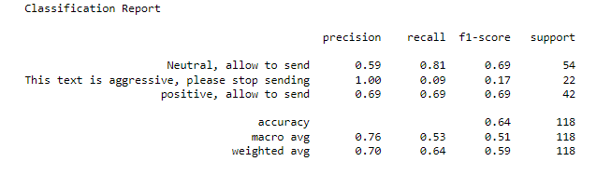
Evaluate example:

Slide 27

Any Questions???

Slide 28

Thank you

